Slide 1
PROGRAMMING IN PYTHON
PYTHON VARIABLES AND OPERATORS
Mrs. C.SHYAMALADEVI M.C.A., M.Phil., B.Ed.,
ASSISTANT PROFESSOR,
DEPARTMENT OF COMPUTER SCIENCE,
SHRIMATI INDIRA GANDHI COLLEGE,
TRICHY-2.

Slide 2
Appreciate the use of Graphical User Interface (GUI) and Integrated Development Environment (IDE) for creating Python programs.
•Work in Interactive & Script mode for programming.
•Create and assign values to variables.
•Understand the concept and usage of different data types in Python.
•Appreciate the importance and usage of different types of operators (Arithmetic, Relational and Logical)
•Creating Python expression (s) and statement (s).

Slide 3
Python is a general purpose programming language
Created by Guido Van Rossum from CWI (Centrum Wiskunde & Informatica) which is a National Research Institute for Mathematics and Computer Science in Netherlands.

Slide 4
The language was released in I991.
Python got its name from a BBC comedy series from seventies- “Monty Python’s Flying Circus”.
Python supports both Procedural and Object Oriented programming approaches.

Slide 5
Key features of Python

Slide 6
It is a general purpose programming language which can be used for both scientific and non-scientific programming
It is a platform independent programming language.
The programs written in Python are easily readable and understandable.

Slide 7
Programming in Python

Slide 8
In Python, programs can be written in two ways namely
Interactive mode
Script mode
The Interactive mode allows us to write codes in Python command prompt (>>>)
In script mode programs can be written and stored as separate file with the extension .py and executed.
Script mode is used to create and edit python source file.

Slide 9
Interactive mode Programming
In interactive mode Python code can be directly typed and the interpreter displays the result(s) immediately.
The interactive mode can also be used as a simple calculator.

Slide 10
Invoking Python IDLE

Slide 11
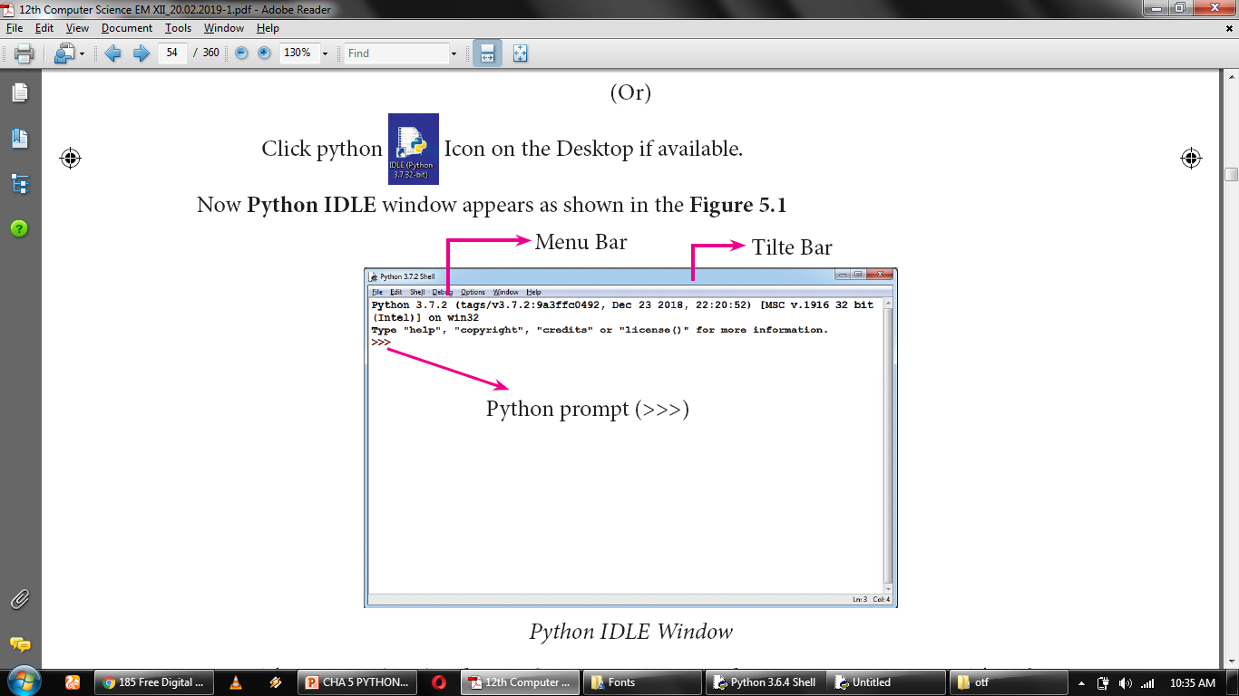

Slide 12
The prompt (>>>) indicates that Interpreter is ready to acceptations. Therefore, the prompt on screen means IDLE is working in interactive mode.

Slide 13
>>> 5/2
2.5
>>> 2/5
0.4
>>> 4%2
0
>>> 5%2
1
>>> 5//2
2
>>> 5+40
45
>>> 5**2
25
>>> 5+5*2
15
>>> a=3
>>> a+=4
>>> print(a)
7

Slide 14
Script mode Programming
A script is a text file containing the Python statements.
Python Scripts are reusable code.
Once the script is created, it can be executed again and again without retyping.
The Scripts are editable.

Slide 15
Input and Output Functions

Slide 16
A program needs to interact with the user to accomplish the desired task; this can be achieved using Input-Output functions.
The input() function helps to enter data at run time by the user.
The output function print() is used to display the result of the program on the screen after execution.

Slide 17
The print() function
In Python, the print() function is used to display result on the screen.

Slide 18
Syntax
print (“string to be displayed as output ” )
print (variable )
print (“String to be displayed as output ”, variable)
print (“String1 ”, variable, “String 2”, variable, “String 3” ……)

Slide 19
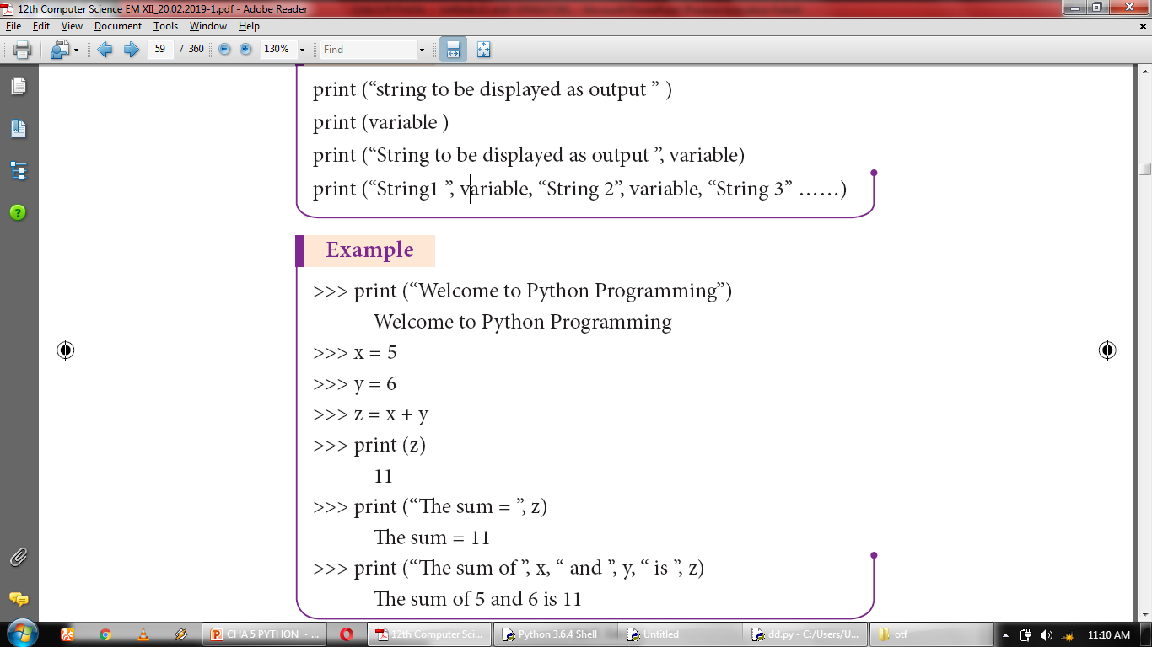

Slide 20
The print () evaluates the expression before printing it on the monitor.
The print () displays an entire statement which is specified within print ( ).
Comma ( , ) is used as a separator in print ( ) to print more than one item.

Slide 21
Example
>>> x=5
>>> y=5
>>> z=x+y
>>> print("The sum of ", x," and" , y," is “ ,z)
The sum of 5 and 5 is 10

Slide 22
input( ) function
In Python, input( ) function is used to accept data as input at run time. The syntax for input() function is,
Variable = input (“prompt string”)

Slide 23
>>> name=input("enter your name:")
enter your name: anupriya
>>> print("i'm ",name)
i’m anupriya
>>> city=input()
trichy
>>> print("im from:",city)
im from: trichy

Slide 24
x,y=int (input("Enter Number 1:")),
int(input("Enter Number 2:"))
Enter Number 1 : 40
Enter Number 2: 30
>>> c=x+y
>>> print(c)
70

Slide 25
Comments in Python

Slide 26
In Python, comments begin with hash symbol (#).
The lines that begins with # are considered as comments and ignored by the Python interpreter.
Comments may be
Single line
Multi-lines.
The multiline comments should be enclosed within a set of # as given below.

Slide 27
Example
# It is Single line Comment
# It is multiline comment
which contains more than one line #

Slide 28
Tokens

Slide 29
Python breaks each logical line into a sequence of elementary lexical components known as Tokens.

Slide 30
1) Identifiers
2) Keywords
3) Operators
4) Delimiters
5) Literals

Slide 31
Identifiers

Slide 32
An Identifier is a name used to identify a variable, function, class, module or object.

Slide 33
An identifier must start with an alphabet (A..Z or a..z) or underscore ( _ ).
Identifiers may contain digits (0 .. 9)
Python identifiers are case sensitive i.e. uppercase and lowercase letters are distinct.
Identifiers must not be a python keyword.
Python does not allow punctuation character such as %,$, @ etc., within identifiers.

Slide 34
Example of valid identifiers
Sum, total_marks, regno, num1
Example of invalid identifiers
12Name, name$, total-mark, continue

Slide 35
Keywords

Slide 36
Keywords are special words used by Python interpreter to recognize the structure of program. As these words have specific meaning for interpreter, they cannot be used for any other purpose.

Slide 37
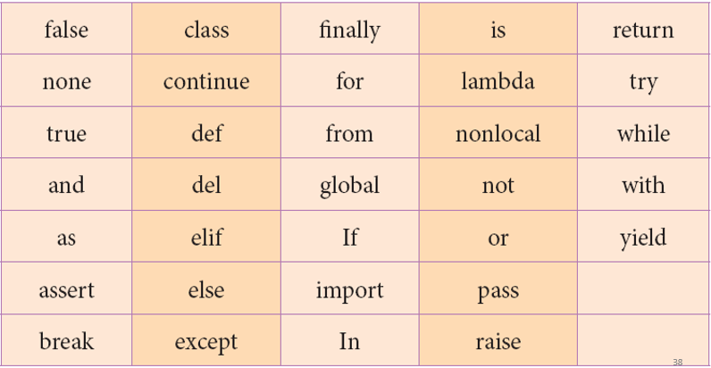

Slide 38
Operators

Slide 39
In computer programming languages operators are special symbols which represent computations, conditional matching etc.

Slide 40
The value of an operator used is called operands.
Operators are categorized as Arithmetic, Relational, Logical, Assignment etc. Value and variables when used with operator are known as operands.

Slide 41
Arithmetic operators

Slide 42
An arithmetic operator is a mathematical operator that takes two operands and performs a calculation on them. They are used for simple arithmetic.

Slide 43
Most computer languages contain a set of such operators that can be used within equations to perform different types of sequential calculations.

Slide 44
>>> a=100
>>> b=10
>>> print ("The Sum = ",a+b)
The Sum = 110
>>> print ("The Difference = ",a-b)
The Difference = 90
>>> print ("The Product = ",a*b)
The Product = 1000
>>> print ("The Quotient = ",a/b)
The Quotient = 10.0
>>> print ("The Remainder = ",a%30)
The Remainder = 10
>>> print ("The Exponent = ",a**2)
The Exponent = 10000
>>> print ("The Floor Division =",a//30)
The Floor Division = 3

Slide 45
Relational or
Comparative operators

Slide 46
A Relational operator is also called as Comparative operator which checks the relationship between two operands.
If the relation is true, it returns True; otherwise it returns False.

Slide 47
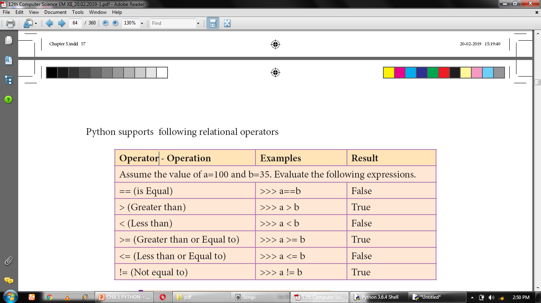

Slide 48
>>> a=10
>>> b=20
>>> a==b
False
>>> a<b
True
>>> a>b
False
>>> a<=b
True
>>> a>=b
False
>>> a!=b
True

Slide 49
Logical operators

Slide 50
In python, Logical operators are used to perform logical operations on the given relational expressions. There are three logical operators they are and, or and not.

Slide 51
Assignment operators

Slide 52
In Python, = is a simple assignment operator to assign values to variable.
Let a = 5 and b = 10 assigns the value 5 to a and 10 to b these two assignment statement can also be given as a,b=5,10 that assigns the value 5 and 10 on the right to the variables a and b respectively. There are various compound operators in Python like +=, -=, *=, /=, %=, **= and //= are also available.

Slide 53
x=int (input("Type a Value for X : "))
print ("X = ",x)
x+=2
print ("X = ",x)
x-=2
print ("X = ",x)
x*=2
print ("X = ",x)
x/=2
print ("X = ",x)
x%=2
print ("X = ",x)
x**=2
print ("X = ",x)
x//=2
print ("X = ",x)
Type a Value for X : 10
X = 10
X = 12
X = 10
X = 20
X = 10.0
X = 0.0
X = 0.0
X = 0.0

Slide 54
Conditional operator

Slide 55
Ternary operator is also known as conditional operator that evaluate something based on a condition being true or false.
It simply allows testing a condition in a single line replacing the multi- line if-else making the code compact.

Slide 56
Syntax
Variable Name = [on_true] if [Test expression] else [on_false]

Slide 57
Example
a=10
b=20
min = a if a < b else b
print("The Minimum value is....", min)

Slide 58
Delimiters

Slide 59
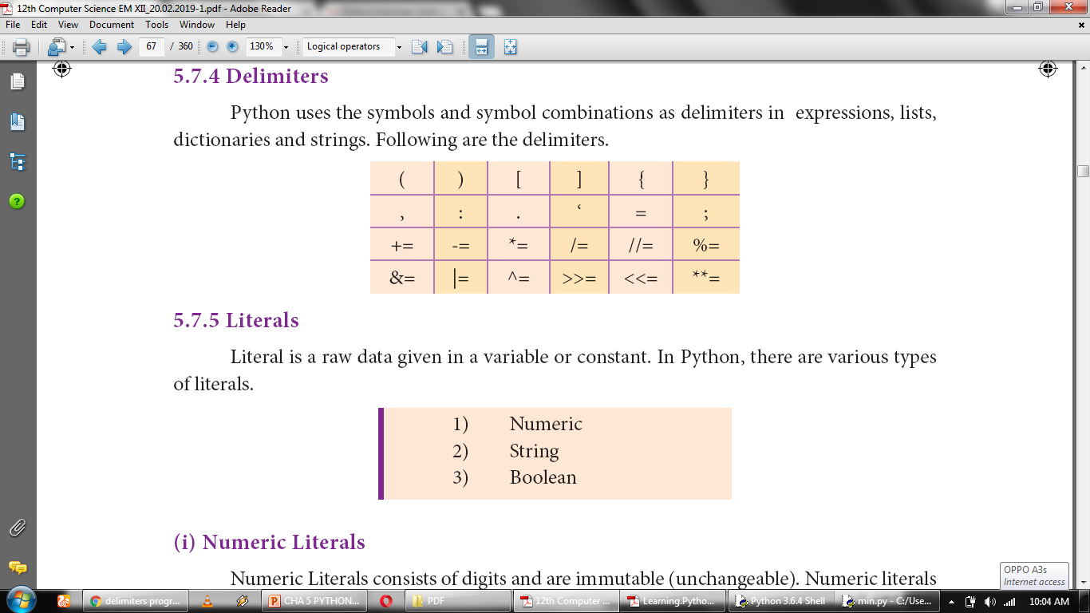
Python uses the symbols and symbol combinations as delimiters in expressions, lists, dictionaries and strings. Following are the delimiters.

Slide 60
Literals

Slide 61
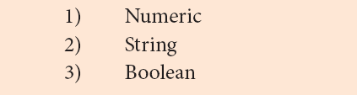
Literal is a raw data given in a variable or constant. In Python, there are various types of literals.

Slide 62
Numeric Literals

Slide 63
Numeric Literals consists of digits and are immutable (unchangeable).
Numeric literals can belong to 3 different numerical types Integer, Float and Complex.

Slide 64
String Literals

Slide 65
In Python a string literal is a sequence of characters surrounded by quotes.
Python supports single, double and triple quotes for a string.
A character literal is a single character surrounded by single or double quotes.
The value with triple-quote "' '" is used to give multi-line string literal.

Slide 66
Boolean Literals

Slide 67
A Boolean literal can have any of the two values: True or False.

Slide 68
boolean_1 = True
boolean_2 = False
print ("Demo Program for Boolean Literals")
print ("Boolean Value1 :",boolean_1)
print ("Boolean Value2 :",boolean_2)
Demo Program for Boolean Literals
('Boolean Value1 :', True)
('Boolean Value2 :', False)

Slide 69
Escape Sequences

Slide 70
In Python strings, the backslash "\" is a special character, also called the "escape" character.
It is used in representing certain whitespace characters: "\t" is a tab, "\n" is a newline, and "\r" is a carriage return.

Slide 71
Python Data types

Slide 72
All data values in Python are objects and each object or value has type. Python has Built-in or Fundamental data types such as Number, String, Boolean, tuples, lists and dictionaries.

Slide 73
Number Data type

Slide 74
The built-in number objects in Python supports integers, floating point numbers and complex numbers.
Integer Data can be decimal, octal or hexadecimal.
Octal integer use O (both upper and lower case) to denote octal digits and hexadecimal integer use OX (both upper and lower case) and L (only upper case) to denote long integer.

Slide 75
Example
# Decimal integers
102, 4567, 567
# Octal integers
O102, o876, O432
# Hexadecimal integers
OX102, oX876, OX432
# Long decimal integers
34L, 523L

Slide 76
A floating point data is represented by a sequence of decimal digits that includes a decimal point.
An Exponent data contains decimal digit part, decimal point, exponent part followed by one or more digits.

Slide 77
Example
# Floating point data
123.34, 456.23, 156.23
# Exponent data
12.E04, 24.e04

Slide 78
Complex number is made up of two floating point values, one each for the real and imaginary parts.

Slide 79
Boolean Data type

Slide 80
A Boolean data can have any of the two values: True or False.

Slide 81
Example
Bool_var1=True
Bool_var2=False

Slide 82
String Data type

Slide 83
String data can be enclosed with single quote or double quote or triple quote.

Slide 84
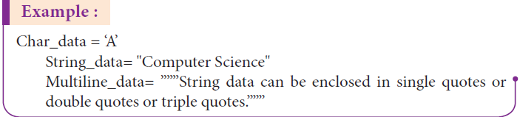

Slide 85
Thank you

